Slide 1

Your people and business together

Slide 2
OUR PURPOSE
We partner with ambitious SMEs to build great places to work, enabling people and business to flourish.​
© Nuvo HR
hello@nuvohr.co.uk
www.nuvohr.co.uk

Slide 3

OUR STORY
© Nuvo HR
hello@nuvohr.co.uk
www.nuvohr.co.uk

Slide 4


OUR STORY

Slide 5
MEET OUR TEAM
© Nuvo HR
hello@nuvohr.co.uk
www.nuvohr.co.uk

Slide 6
MEET OUR TEAM
© Nuvo HR
hello@nuvohr.co.uk
www.nuvohr.co.uk

Slide 7






OUR VALUES
Provide Value
Break the Mould
Grow with Curiosity
Win Together
Do What’s Right
We focus on what matters, delivering tangible value that helps businesses and people grow stronger, not just ticking HR boxes.
We’re not your average HR partner. We combine strategy, creativity, and commercial thinking to bring a fresh, modern approach to people challenges.
Collaboration drives everything we do across our team, our clients, and their people. When we work together, everyone succeeds.
Integrity guides us. We act with honesty, fairness, and respect, building trust that lasts beyond every project or partnership.
We never stop learning. Our passion for progress and insight fuels better ideas and smarter solutions.

Slide 8

We work with employers who want to...
  Build an inspiring reputation as an employer
  Grow their business from the right foundations
  To be responsible and ensure all employment law requirements are met
  Develop a culture that enables their people to flourish

Slide 9



OUR SERVICES
Together, we develop a People Plan which aligns your people and your business
Compliance
Culture
People Processes
© Nuvo HR
hello@nuvohr.co.uk
www.nuvohr.co.uk

Slide 10


COMPLIANCE
  Ensure you meet your legal requirements
  Contracts
  Essential policies/Employee Handbook
  Right to Work checks
  Data Protection
  Support for any people challenges

Slide 11
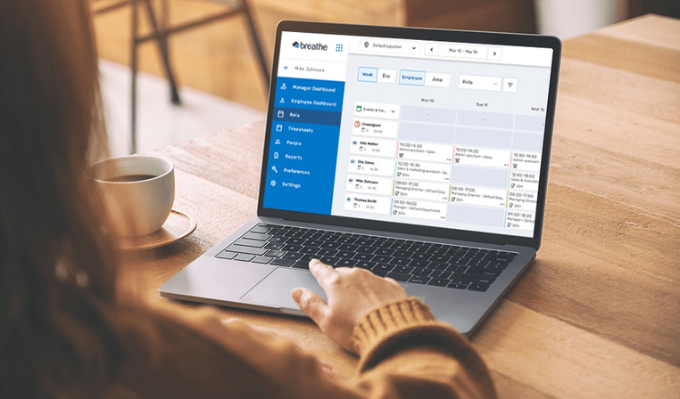

HR SOFTWARE
  Employee self service
  Holiday and leave requests
  Sickness absence
  Electronic line manager approvals
  Share company policies
  Manage company and individual objectives

Slide 12







CULTURE
How I feel about my company
Getting a fair deal
Relationship with my manager
Recognition for my work
Making a meaningful contribution
Wellbeing at work
Opportunities for personal growth
How I feel about my team
“Wheel of Fortune”

Slide 13


PEOPLE PROCESSES
Exit
Develop
Reputation
Reward & Benefits
Recruit
Manage
Onboard
Employee Life Cycle

Slide 14


LEARN

Slide 15

HR MENTOR
Offers support to HR Teams and HR Managers
Providing HR for HR
Complex employee relations work, independent input
Sounding board for decision making and best way forward
© Nuvo HR
hello@nuvohr.co.uk
www.nuvohr.co.uk

Slide 16
BENEFITS OF WORKING WITH US
  Covering the services and expertise of an entire HR Department
  On-site presence available
  Dedicated service, covering the full working year
  Birds eye view of the external market
  Maintaining impartiality and confidentiality within a small team
  Genuine benchmarking against other employers
  Value-adding resource removed from time consuming aspects of the day to day
  Professional development and mentoring opportunities for internal HR team and Line Managers
  Flexible service to grow with the organization- we’re with you for the journey!

Slide 17






CLIENTS WE HAVE WORKED WITH
© Nuvo HR
hello@nuvohr.co.uk
www.nuvohr.co.uk

Slide 18
WHAT OUR CLIENTS SAY ABOUT US
© Nuvo HR
hello@nuvohr.co.uk
www.nuvohr.co.uk

Slide 19
Thank You!

